Slide 1

Intro to Practical development
Making things with raspberry Pi and Python!

Slide 2



before we begin
Logistics and important info
Introductions
Name
What do you want to learn today?
Last time you apologized?
Notes:
LOGISTICS
INTRODUCTIONS

Slide 3
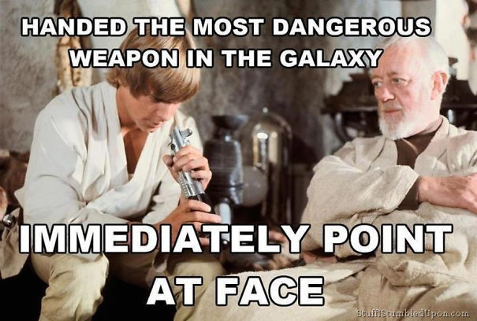
What will you get out of today’s session?
Just enough to be dangerous CURIOUS and do more!
Notes:
THIS IS DESIGNED TO GIVE YOU THE BASICS SO YOU CAN GO FURTHER ON YOUR OWN

Slide 4
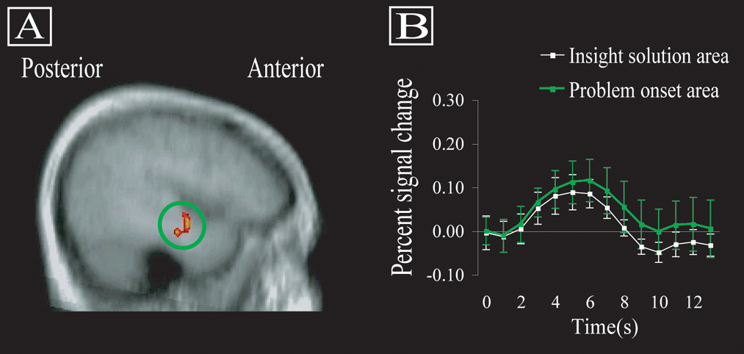
Practical Development
Why “practical” development?
Physical confirmation of logical creations
The “aha” moment
Notes:
WHY PRACTICAL DEVELOPMENT?
WHY THIS PROJECT?
WHERE DID THIS IDEA COME FROM?

Slide 5
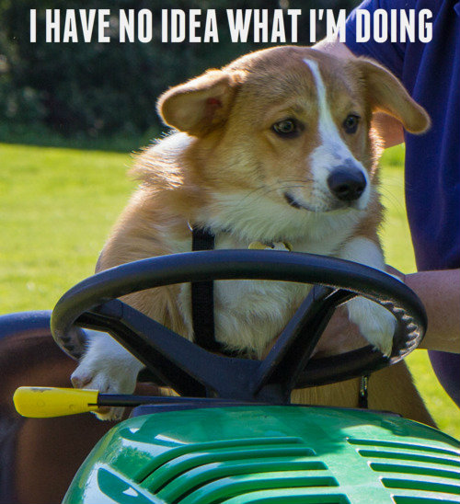

What *are* we doing?
Building our prototype
Coding our application
Testing our solution
Making! Hacking! Developing!

Slide 6
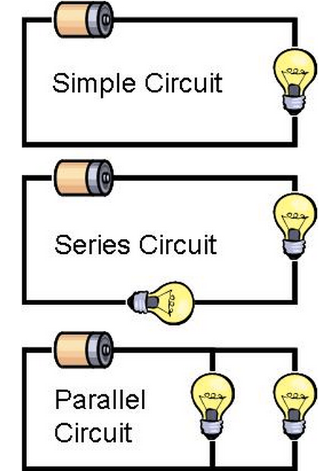
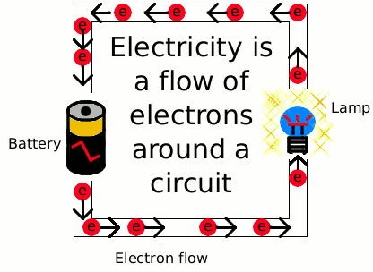

Hardware fundamentals
Building hardware is all about controlling electricity
Flow is controlled through a circuit
You will have mastered electricity and basically be an X-Men*
*Inclusion in X-Men adventures not guaranteed
Notes:
Power out is the “faucet”
Ground or the + terminal is the “drain”
Wiring is a lot like plumbing

Slide 7
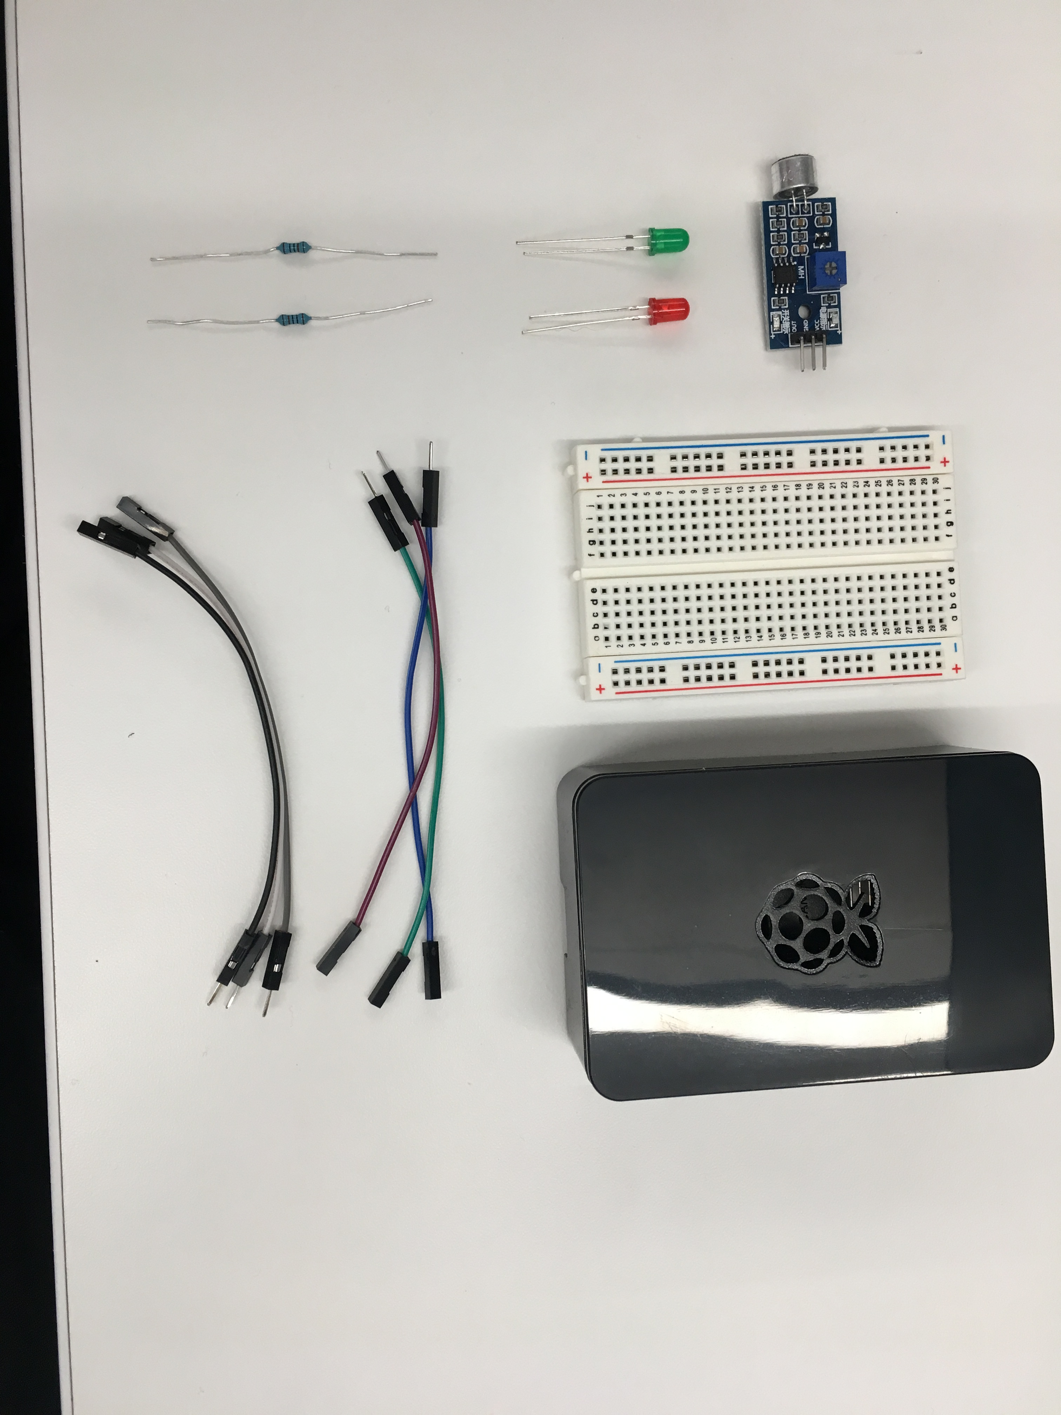
OUR Hardware – AKA What’s in this box?
Basic hardware required to build our project
Breadboard
Wires
Lights
Resistors
Sensor
Raspberry Pi 3

Slide 8
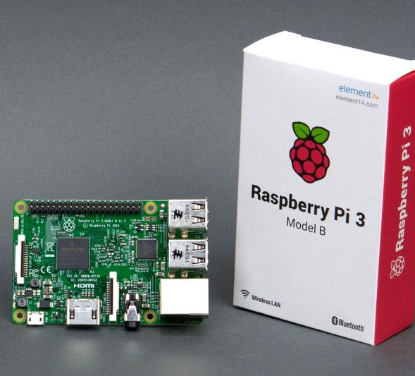
Raspberry Pi
Why Pi for IoT?
Cost
Accessibility
Community
Peripherals
First to market
Small, light, and “good enough”

Slide 9
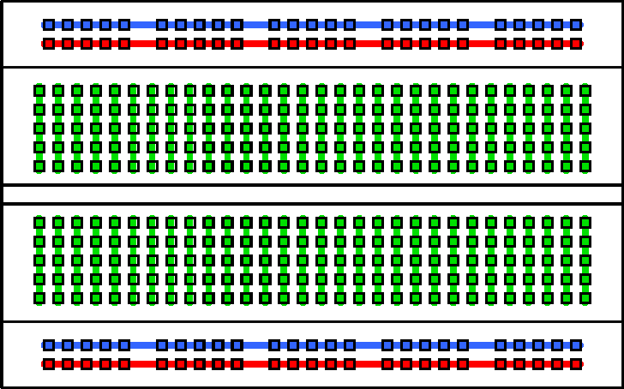
Breadboard basics
Terminal Strips
Columns (#’s)
I2C “Ravine”
Rows (Letters)

Slide 10
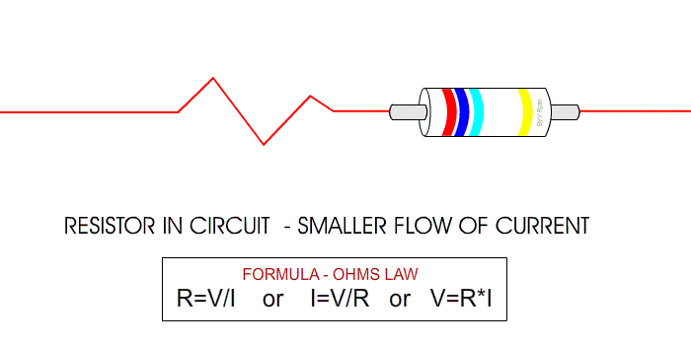
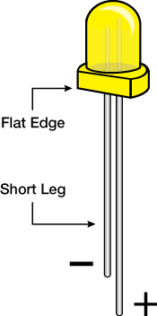
Resistors and LEDs

Slide 11
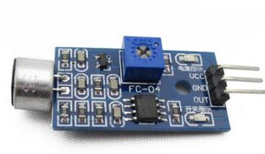
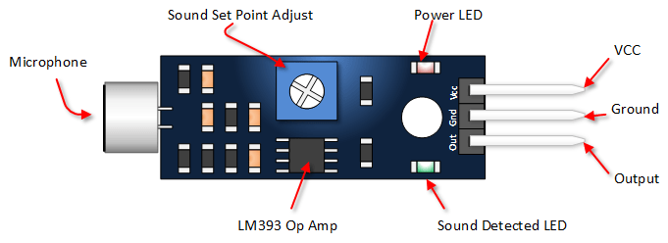
SENSOR Basics
Common Sensor pinout:
VCC = power IN
GND = power OUT (Ground)
Out(put) = signal out
Sometimes you get:
A0 = Analog output
D0 = Digital output

Slide 12
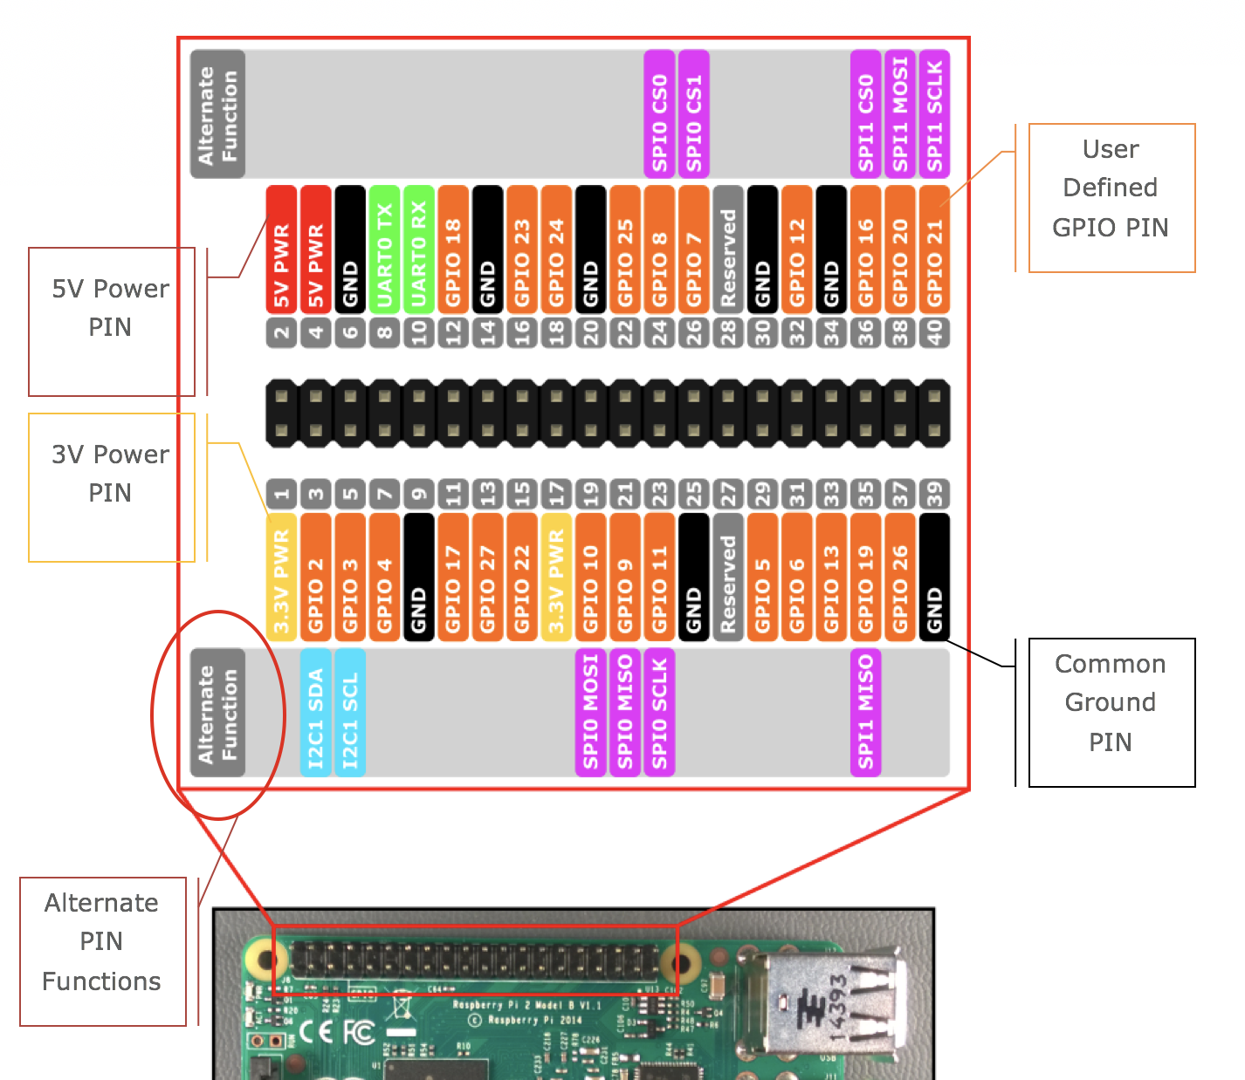
A pinout ‘splainer
Power
Ground
SPIO
Alternate Functions
Notes:
Page 7 in the companion

Slide 13
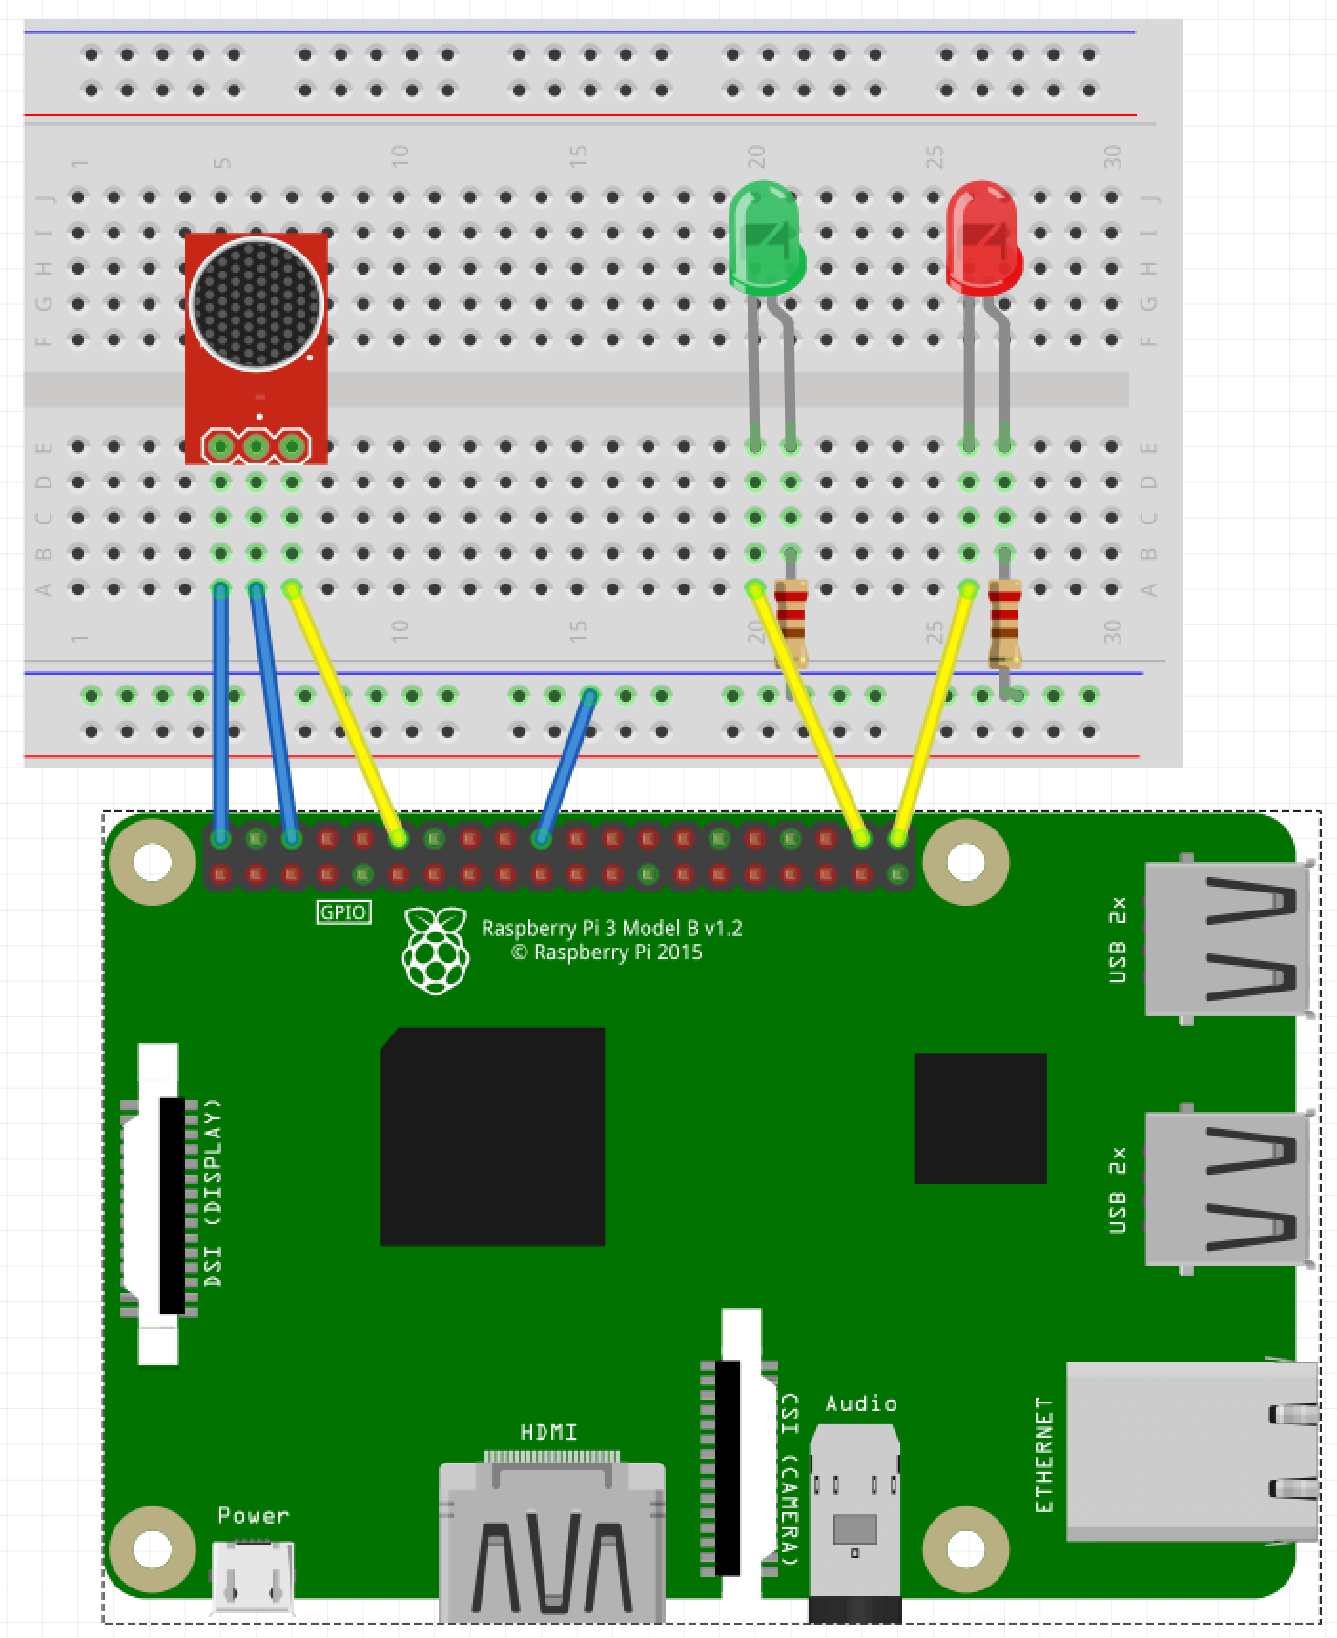
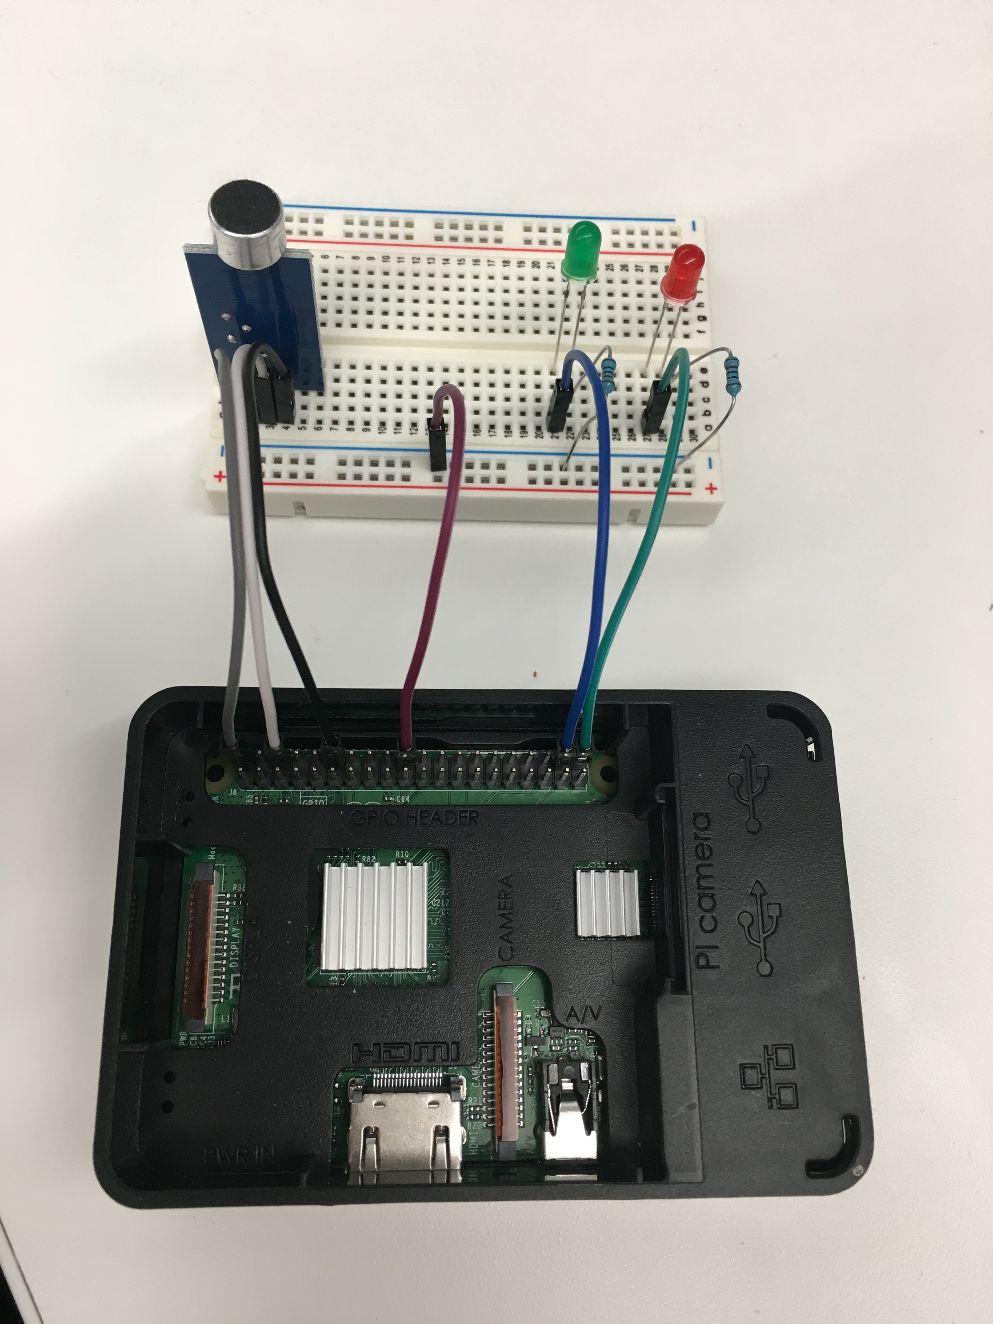
Slapping it all together
KISS – keep it simple, son!
Notes:
During the build talk about things like:
Prototype vs commercial
Screwing around versus functional building
Long-term things you can do to get serious

Slide 14

Now we have a Fancy Brick
It looks cool!
It matches the picture
It doesn’t do anything
Yet!

Slide 15

Take 15 minutes to RECOVER!

Slide 16

Take 15 more minutes to celebrate!

Slide 17
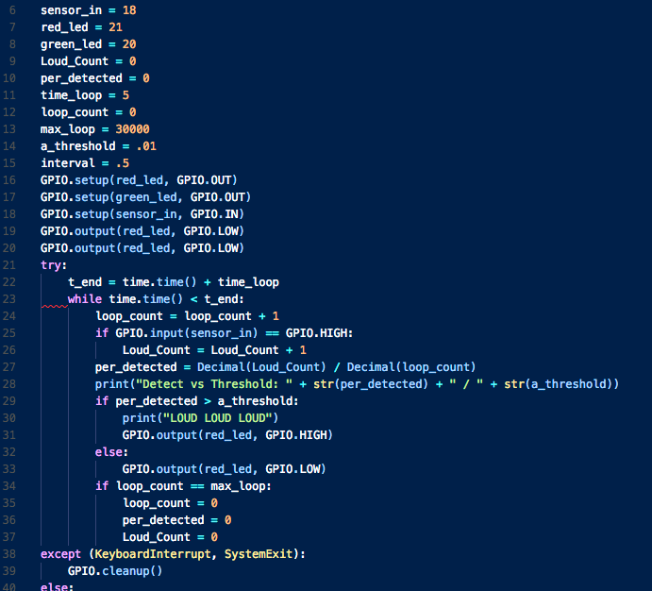
Software BASICS
Variables
Functions
Inputs
Outputs
Notes:
Languages and syntaxes and etc… all boil down to 4 things:

Slide 18
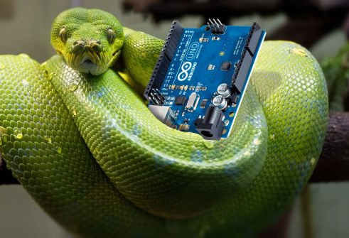

AS regards Python
Compact
Terse
Dynamically Typed
Control Characters
Structure (Indentation)

Slide 19
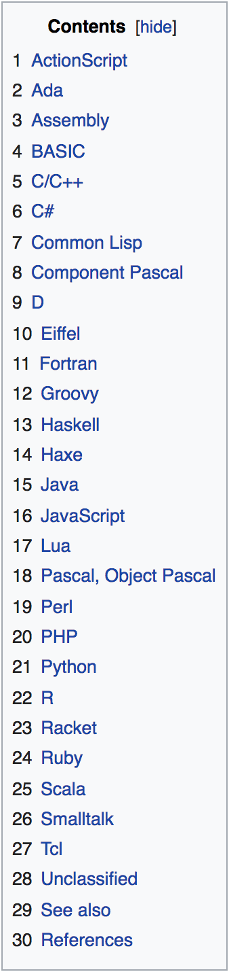

Code power!
How do we “build” software?
What are the resources you need?
Keeping track of code?

Slide 20
Getting started with writing code
A development tool
A place to save code
Access to other libraries and info

Slide 21
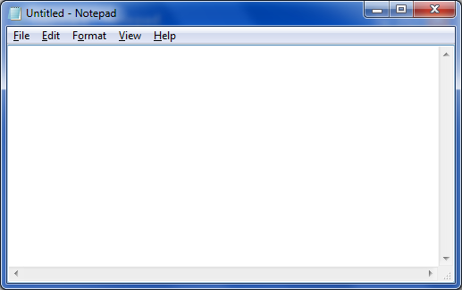
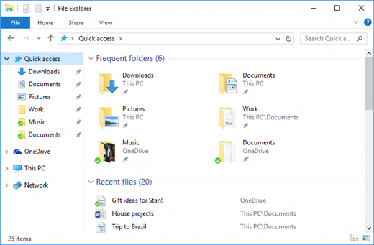









A TOOL
A PLACE TO PUT IT
RESOURCES

Slide 22
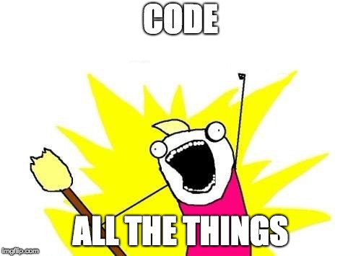

IT’s Coding time!

Slide 23
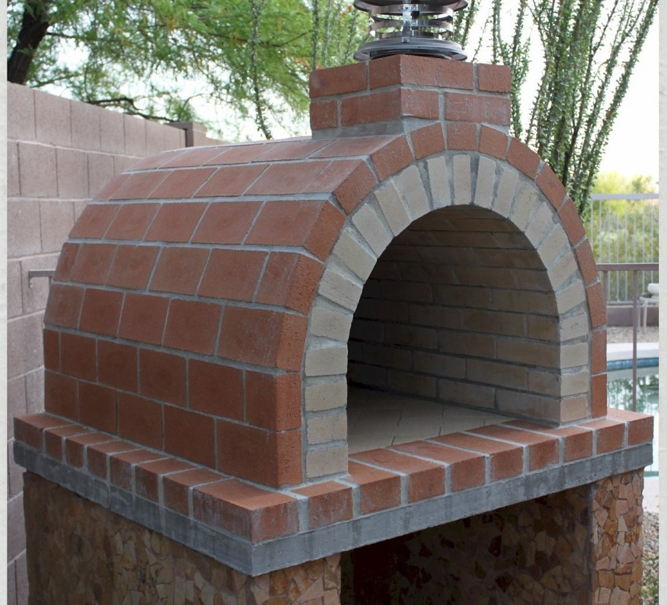
You have now made a brick oven!
It serves a functional purpose
It doesn’t just sit there
It works like you coded it to!

Slide 24
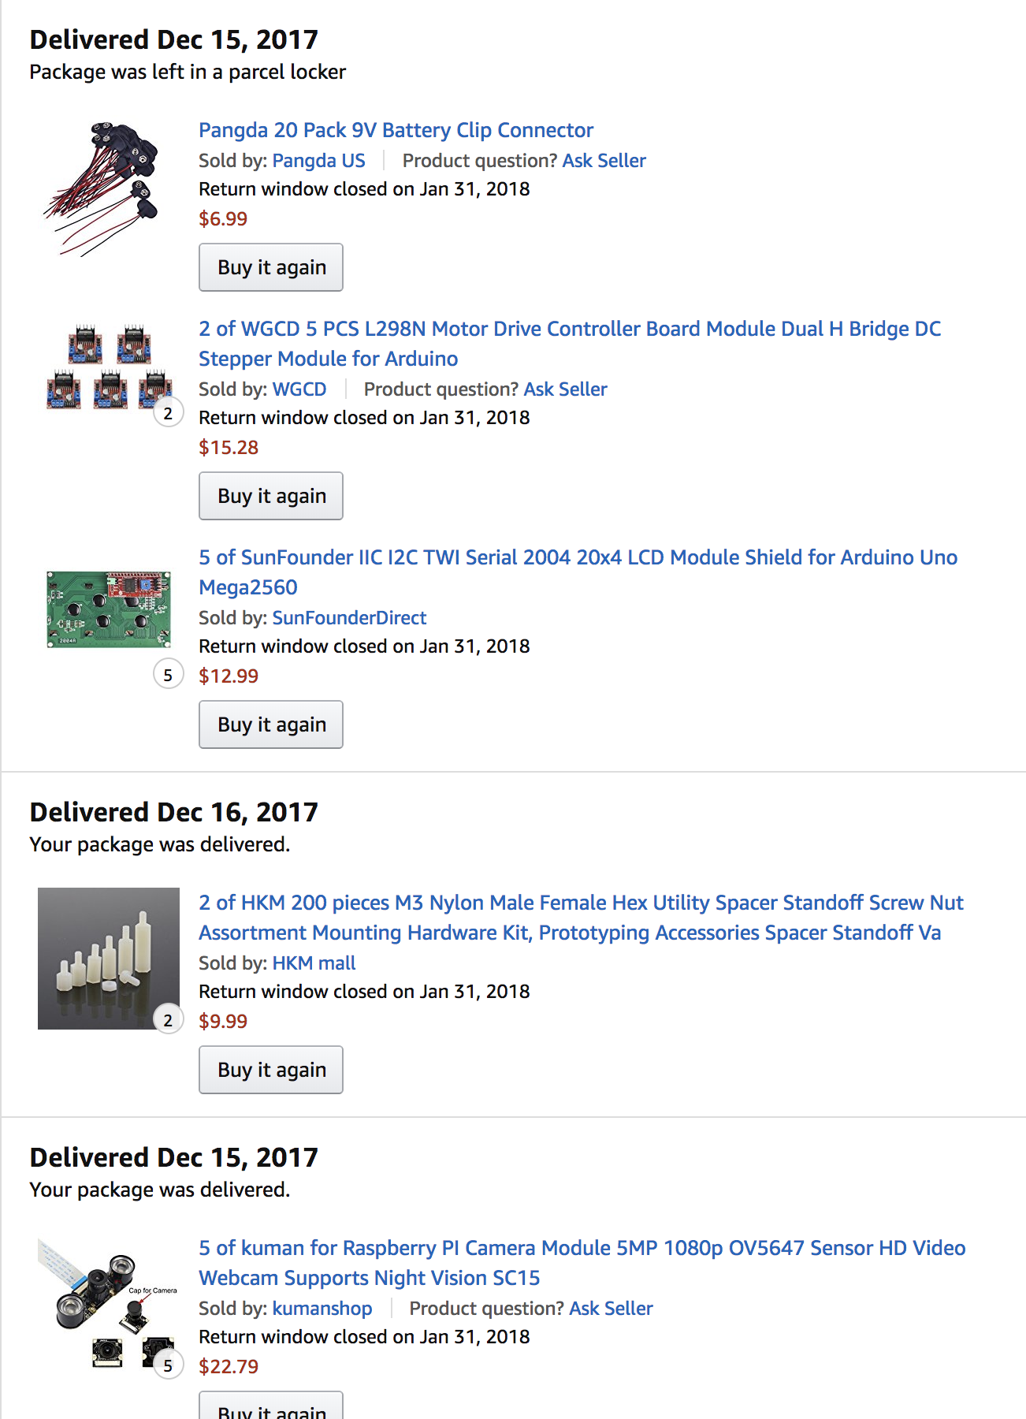
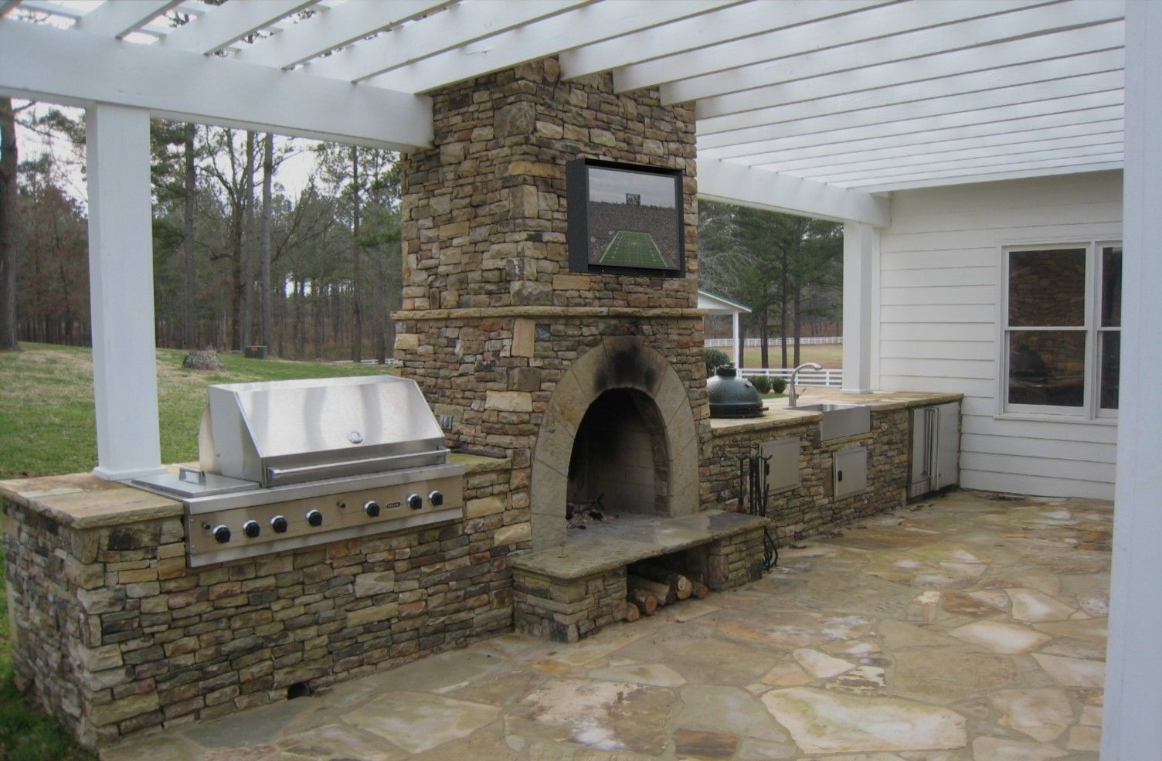
What’s next?
You have just taken the ”gateway drug” of making
Now your little oven will start to trigger new ideas and things you want to add
Soon you will have a fancy brick oven!
And your amazon order history will look like this:

Slide 25

Congratulations!
You’re officially an IoT Developer! Don’t forget to come get your Sticker!!

Slide 26
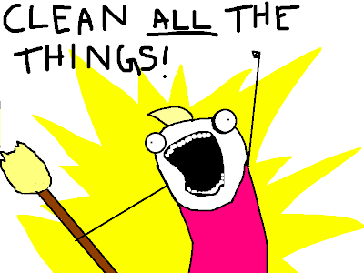
While we do Q and a
Disassemble your circuits
Put the parts in the baggie
Put everything back in the box
If you *really* want to keep your kit, let’s talk after

Slide 27
Some resources for you And a Favor for me
Official Resources:
Raspberypi.org
Python.org
Other Resources:
Youtube! Instructables! Amazon!
Github.com/ChrisHarrold
@charrold303 @codecoffeeyvr
A Favor:
http://bit.ly/charrold

